Slide 1
Introduction to Generative AI
Generated by Groq AI

Slide 2
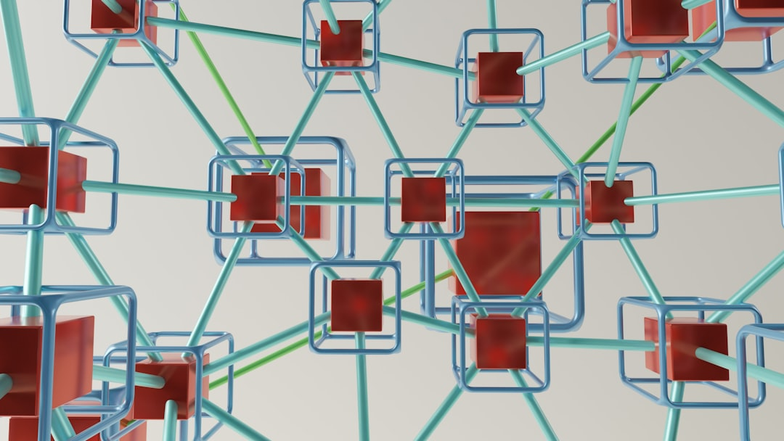
Types of Generative AI Models
• Generative Adversarial Networks (GANs) are a type of generative AI model that consists of two neural networks: a generator and a discriminator, which compete with each other to generate new content that is indistinguishable from real data.
• Variational Autoencoders (VAEs) are another type of generative AI model that uses a probabilistic approach to learn the distribution of a dataset and generate new content by sampling from this distribution.
• Transformers are a type of generative AI model that is particularly well-suited for natural language processing tasks, such as language translation and text generation.
• Autoregressive models, such as PixelCNN and WaveNet, are a type of generative AI model that generates new content one pixel or sample at a time, based on the previous pixels or samples.
• Hybrid models, which combine different types of generative AI models, such as GANs and VAEs, are also being developed to leverage the strengths of each approach.

Slide 3
Applications of Generative AI
• Generative AI has the potential to revolutionize the field of art and design, by enabling the creation of unique and personalized visual content, such as paintings, sculptures, and product designs.
• In the entertainment industry, generative AI can be used to generate special effects, such as explosions and fire, as well as to create personalized avatars and characters.
• In healthcare, generative AI can be used to generate synthetic medical images, such as X-rays and MRIs, which can be used to train machine learning models and improve diagnosis accuracy.
• In marketing, generative AI can be used to generate personalized product recommendations and advertisements, based on a customer's preferences and behavior.
• Generative AI can also be used to generate realistic videos and audio, which can be used in a variety of applications, such as virtual reality and video conferencing.

Slide 4
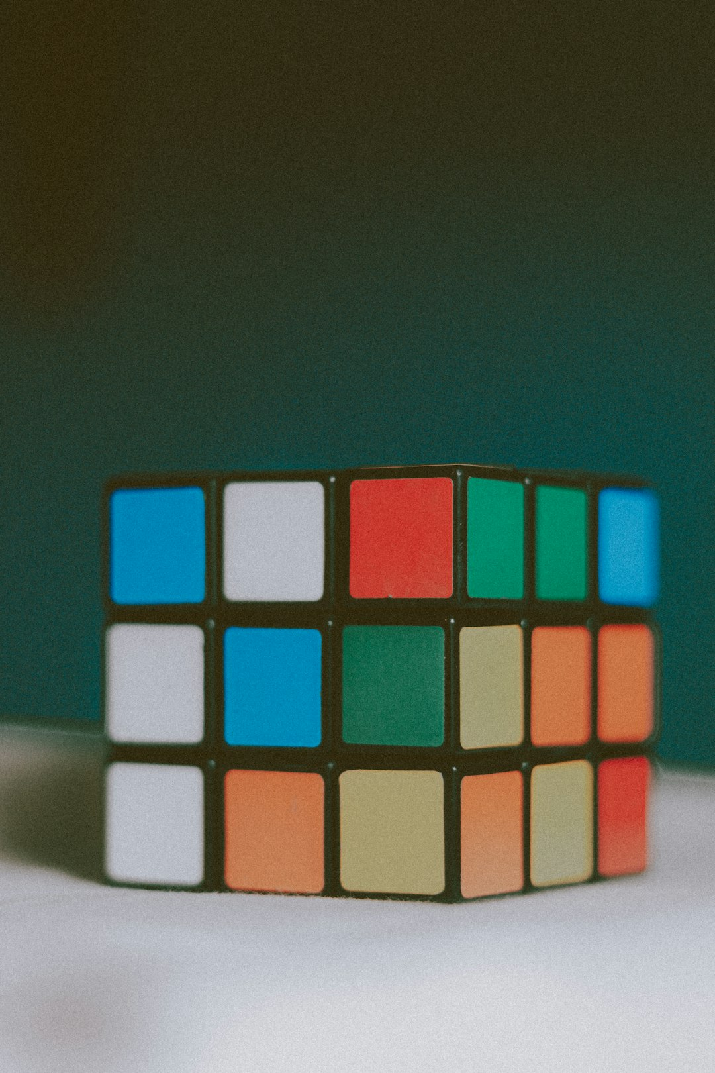
Challenges and Limitations of Generative AI
• One of the major challenges of generative AI is the potential for misuse, such as the creation of deepfakes or fake news articles, which can have serious consequences, such as damaging someone's reputation or influencing the outcome of an election.
• Another challenge is the need for large amounts of high-quality training data, which can be difficult to obtain, especially for certain types of data, such as medical images.
• Generative AI models can also be computationally expensive to train and deploy, which can make them inaccessible to smaller organizations or individuals.
• Furthermore, the evaluation of generative AI models can be challenging, as it is difficult to define a clear metric for evaluating the quality and realism of generated content.
• Finally, there are also concerns about the potential for generative AI to displace human workers, particularly in creative fields, such as art and design.

Slide 5
Conclusion and Future Directions
• In conclusion, generative AI is a rapidly evolving field that has the potential to revolutionize various industries and applications.
• However, it also raises important questions about authorship, ownership, and the potential for misuse, which need to be addressed through further research and development.
• Future directions for generative AI include the development of more advanced models and techniques, such as multimodal generative models and conditional generative models.
• There is also a need for more research on the social and economic implications of generative AI, including its potential impact on employment and the creative industries.
• Ultimately, the successful development and deployment of generative AI will require a multidisciplinary approach that brings together experts from computer science, art, design, and social sciences.

